Slide 1
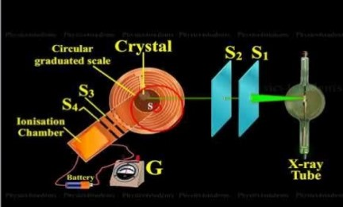
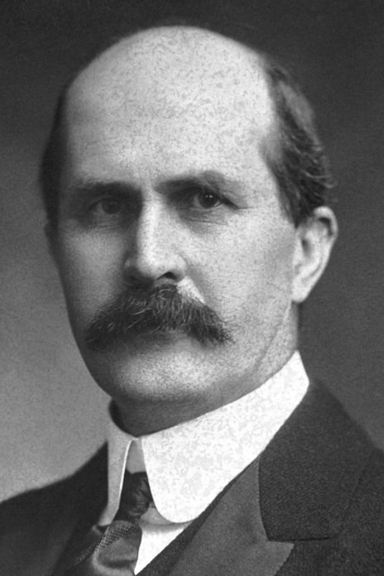
BPM: 2 Engineering Physics-II
UNIT –I: Crystal Structures and X-ray Diffraction
Lecture-7
By- Prof. B. K. Pandey, Dept. of Physics and Material Science
Sir William Henry Bragg The Nobel Prize in Physics 1915

Slide 2

X-rays and Compton Effect
In 1985 Professor Wilhelm Condrad Röntgen found some highly penetrating radiations named as X-rays.
X-Rays are electromagnetic rays having shorter wavelength lying in the range from 0.01 Å to 10 Å.

Slide 3
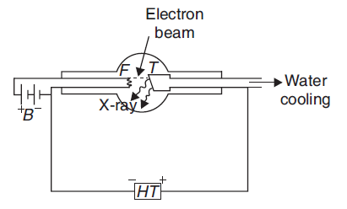
PRODUCTION OF X-RAYS
When electrons with high value of kinetic energy collide with the target metal of high melting point and large atomic weight, X-rays are produced.
Coolidge tube producing X-rays

Slide 4
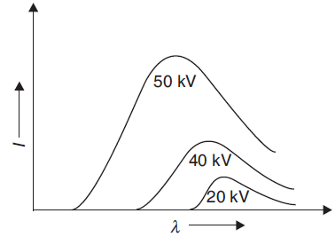
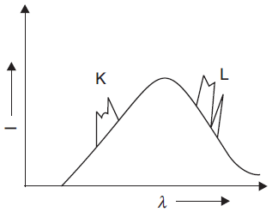
X-RAY SPECTRA
Continuous Spectra
Characteristic Spectra

Slide 5

Origin of characteristic X-ray spectra
When high velocity electrons penetrates through the outer shells of the target atom and strikes with an electron in the inner shell.
Due to collision electron from the inner shell is knocked out vacancy is created and to fill it, an electron from higher energy state jumps into this vacancy.
The difference in energy is emitted as X-rays photon of energy ΔE = hν.

Slide 6
Origin of characteristic X-ray spectra
When high velocity electrons penetrates through the outer shells of the target atom and strikes with an electron in the inner shell.
Due to collision electron from the inner shell is knocked out vacancy is created and to fill it, an electron from higher energy state jumps into this vacancy.
The difference in energy is emitted as X-rays photon of energy ΔE = hν.

Slide 7
PROPERTIES OF X-RAYS
X-rays are electromagnetic radiations like light.
They possess reflection, refraction, diffraction, and interference.
Have very short range of wavelength, lying between 0.01 Å and 10 Å.
They are not deviated by either electric or magnetic field.
Ionize the gas through which they pass.
Penetrate the solid materials.
Affect photographic plate.
Cause fluorescence.

Slide 8
DIFFRACTION OF X-RAYS
For testing the wave nature of X-rays, scientists tried to obtain the diffraction pattern of X-rays.
But due to short wavelength of X-rays, man-made transmission gratings is
practically impossible.
The diffraction pattern of a wave is obtained only if the aperture is of the order of the wavelength of the diffracting wave.
Therefore, transmission gratings having 40 million lines/cm are required for diffracting X-rays. Thus, natural crystals can be used as grating for diffraction of X-rays.

Slide 9
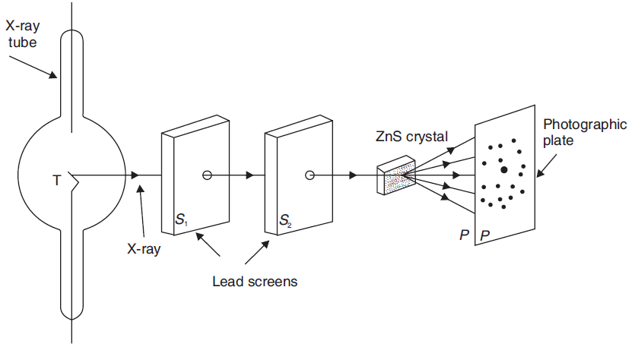
LAUE’S EXPERIMENTAL DEMONSTRATION
Laue obtained diffraction pattern of X-rays passing through a three-dimensional
crystal grating. The experimental arrangement of Laue’s demonstration is shown in figure.
Fig 2: Laue’s Experiment

Slide 10
Diffraction pattern is obtained at photographic plate. This pattern consists
of a central spot, surrounded by a series of fainter spots in a definite pattern.
The symmetrical pattern of spots is called Laue’s pattern or Laue’s spots.
Laue’s spots prove that X-rays are electromagnetic waves.
Laue’s experiment established the following two important facts:
(i) X-rays are electromagnetic waves of short wavelength.
(ii) In crystals, atoms are arranged in a three-dimensional lattice.

Slide 11
BRAGG’S LAW
Bragg considered that a crystal is made up of a number of parallel planes on which atoms are arranged in a regular fashion.
When X-rays are allowed to fall on the crystal, reflections from different planes take place. These reflected rays interfere and produce diffraction pattern.
Let us consider a narrow beam of X-rays of wavelength λ. It is allowed to incident on a crystal of parallel lattice planes having inter-atomic (lattice planes) separation of d. Let us assume the glancing angle to be θ.

Slide 12
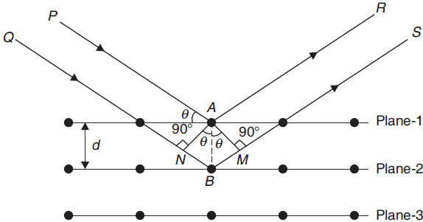
It is known that incident rays are reflected from various parallel planes of atoms in the crystal.
The diffraction pattern of reflected radiation is observed only when reflections from various planes of atoms interfere constructively.

Slide 13
Let us suppose that ray PA is reflected from atom A in the direction AR and ray QB is reflected from atom B in the direction BS.
If the path difference between AR and BS satisfies the condition of constructive interference, then a diffraction pattern will be observed.
The path difference between the reflected rays AR and BS can be given as (NB + BM).
From the fig. NB = BM = d sin θ
Hence, the path difference can be given as
(NB + BM) = 2d sin θ
If this path difference is an even multiple of λ/2 (i.e., n λ), then the two rays will reinforce each other and produce an intense spot. Thus, the condition of reinforcement can be given as
2d sin θ = n λ
where n = 1, 2, 3, etc.
It is known as Bragg’s law.

Slide 14
BRAGG’S SPECTROMETER
For the structural studies of crystals, W.H. Bragg and his son W.L. Bragg devised a spectrometer in which a crystal is used as a reflection grating instead of a transmission grating. With the help of their spectrometer, inter atomic separation in the crystal can be calculated.
Bragg’s spectrometer consists of a source of X-rays S, slits S1 and S2, and crystal C mounted on a prism table. A round scale, consisting of two vernier scales V1 and V2 to note down the angle, is attached with the prism table. An ionization chamber is attached with the prism table, along with a galvanometer.

Slide 15
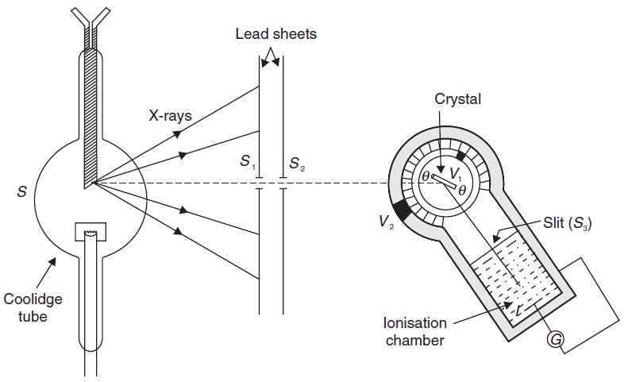
BRAGG’S SPECTROMETER
Fig. 4 Bragg’s spectrometer

Slide 16
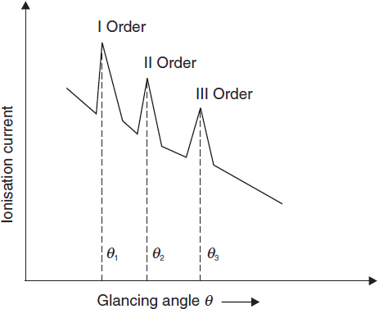
The graph plotted between the ionization current I and glancing angle θ for the NaCl crystal is shown in Figure.
The number of peaks in the curve corresponds to those glancing angles which satisfy Bragg’s equation, i.e.,
2d sin θ = n λ

Slide 17
From the experimental observations, the following facts have been established:
(i) As the order of spectrum increases, the intensity of the reflected X-rays decreases.
(ii) The ionization current does not fall to zero for any value of glancing angle θ, but it does attain a maximum value for certain glancing angles.
It indicates that there is continuous spectrum over which the characteristic line spectrum is superimposed.

